Slide 1
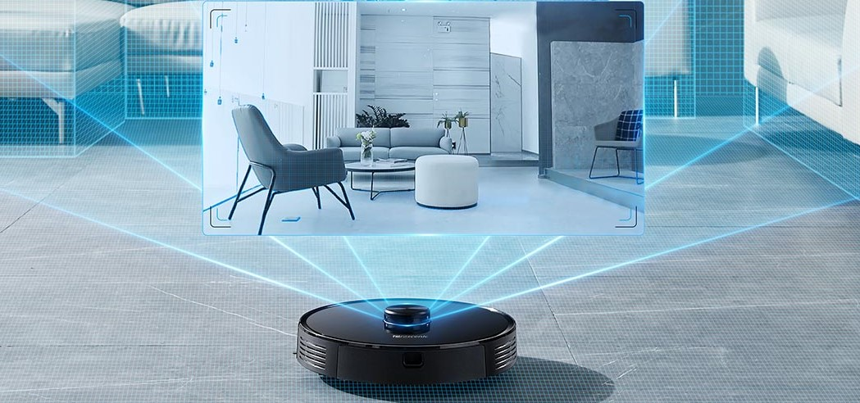
Presentation on CSE561 Project
COMPARISION BETWEEN PERFORMANCE OF DIFFERENT KINDS OF BATTERIES USED IN ROBOTIC VACUUM CLEANERS
BY: SWATI MAHAPATRA
VIRAJ SONAJE

Slide 2
MOTIVATION
An autonomous robotic vacuum cleaner offers floor cleaning system.
An automated vacuum cleaner must have:
Good battery performance - how long you can use it
Smart decision-making capability - how it cleans the surface without disturbing the surrounding objects or humans.
Different environments need different types of Robovacs depending on the amount of work to be done thus maintaining battery levels while operating.
This is our motivation for this project.

Slide 3
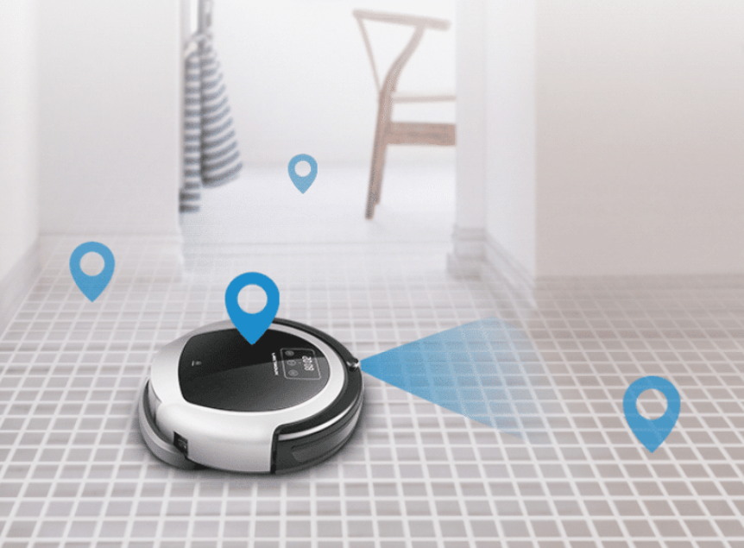
OBJECTIVE
To design models of Robovacs with different kinds of batteries.
Do case studies : Comparing the performance of different battery types in Robotic vacuum cleaners when exposed to various constraints and environments.

Slide 4
SYSTEM DESCRIPTION
Power Supply (Battery)
Multiple batteries as an energy source (considered as continuous energy supply)
Monitor its usage for every type of environment
Specification of the actuators and sensors
Time for which it is being used.
Motors
Used to move the wheels of the bot (states are the movement directions: North, South, East, West, SouthEast, SouthWest, NorthEast, NorthWest).
To operate the suction pump at the intake port (states are active and passive)

Slide 5
Sensors
Consists of :
(LiDAR) sensor - used to scan the room and create a virtual map of the space around it.
Infrared (IR) sensor - to detect obstacles and dust particles during the actual operation of the bot.
Electronic control unit
Responsible to take in all the inputs from the sensors and guide the actuators of the system.

Slide 6
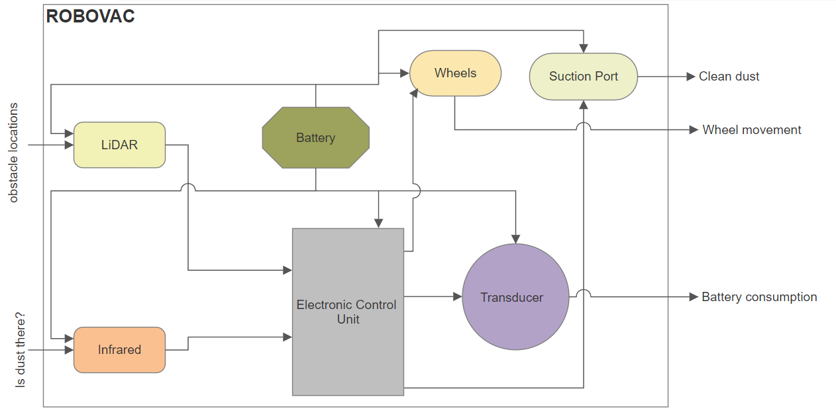
Block Diagram

Slide 7
Assumptions
We have taken the following assumptions while designing the system model and its simulation:
Environment is assumed as a grid.
The following finite time assumptions have been taken:
To move from one cell to another : 2 seconds.
Suction pump to clean :10 seconds.
ECU : 1 second.

Slide 8
Current consumption of components:
LIDAR: 625mA
IR: 20mA
ECU: 50mA
Suction pump: 7000 mA
Wheels: 900mA
Batteries used: Battery 1- Lithium Ion, Battery 2- Lead Acid

Slide 9
Following is the video for the simulation model:

Slide 10
Thank You!

